Slide 1

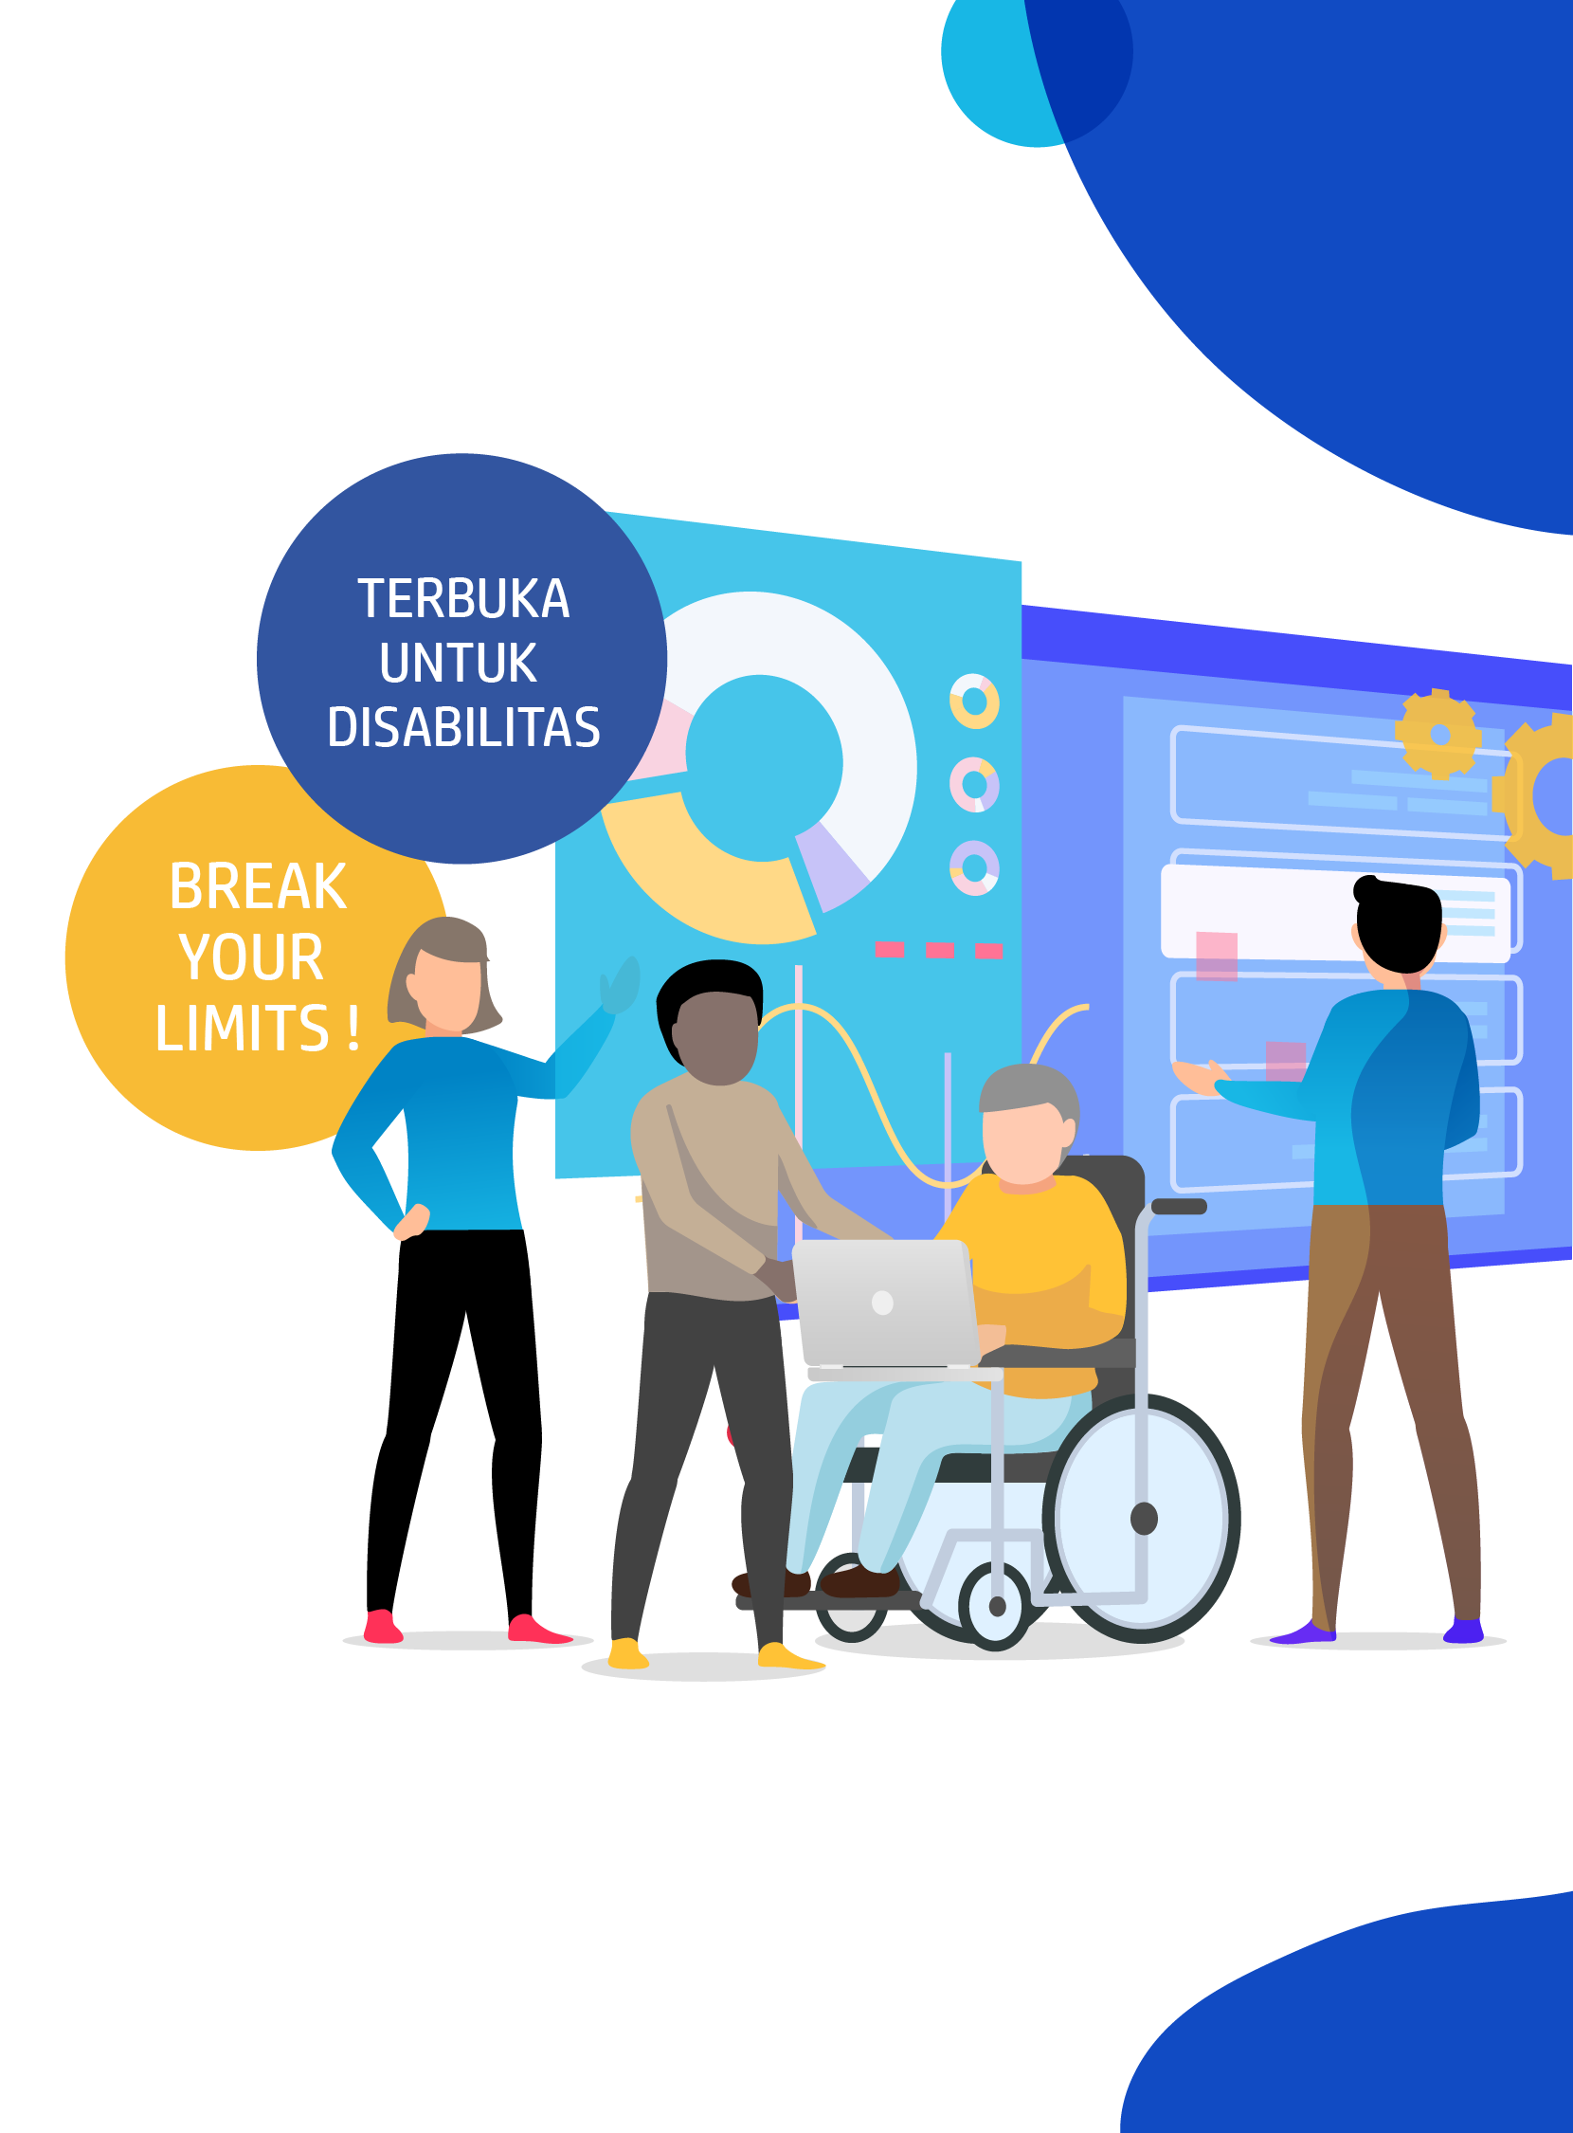




DIGITAL TALENT SCHOLARSHIP
2019
digitalent.kominfo.go.id

Slide 2
Deep Learning Models

Slide 3

Restricted Boltzmann Machines
Bagian 1
Notes:
So what was it that allowed researchers to overcome the vanishing gradient problem?

Slide 4
Restricted Boltzmann Machine is a method that can automatically find patterns in our data by reconstructing the input

Slide 5
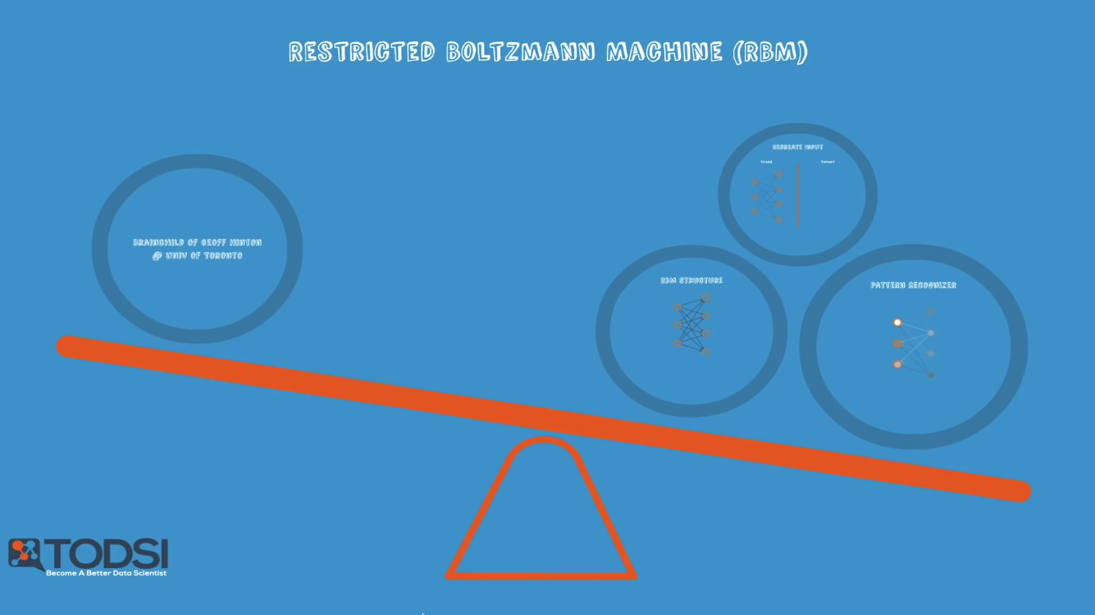
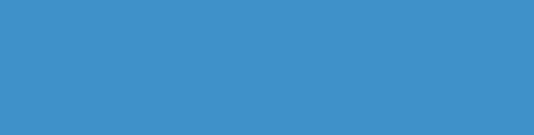
Restricted Boltzmann Machine

Slide 6

Geoff Hinton at the University of Toronto was one of the first researchers to devise a breakthrough idea for training deep nets.
Notes:
His approach led to the creation of the Restricted Boltzmann Machine, also known as the RBM.

Slide 7

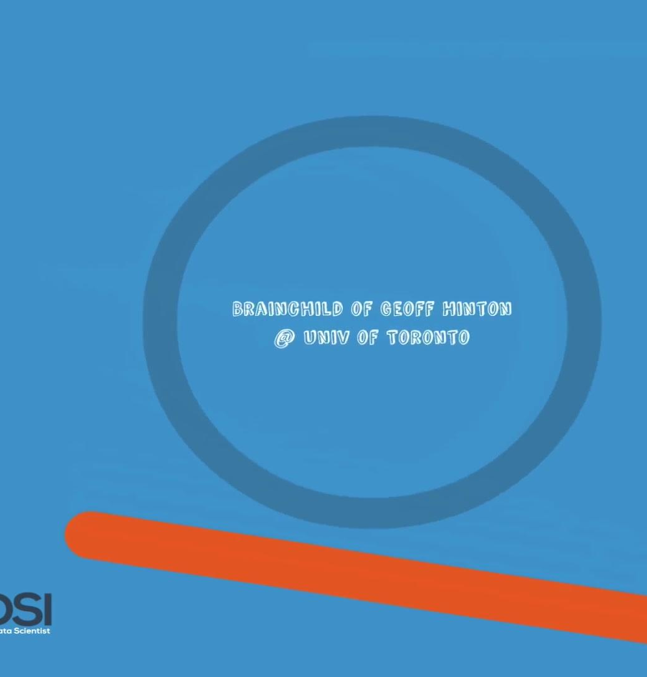
Restricted Boltzmann Machine
Because of his pioneering work he’s often referred to as one of the father’s of deep learning.

Slide 8
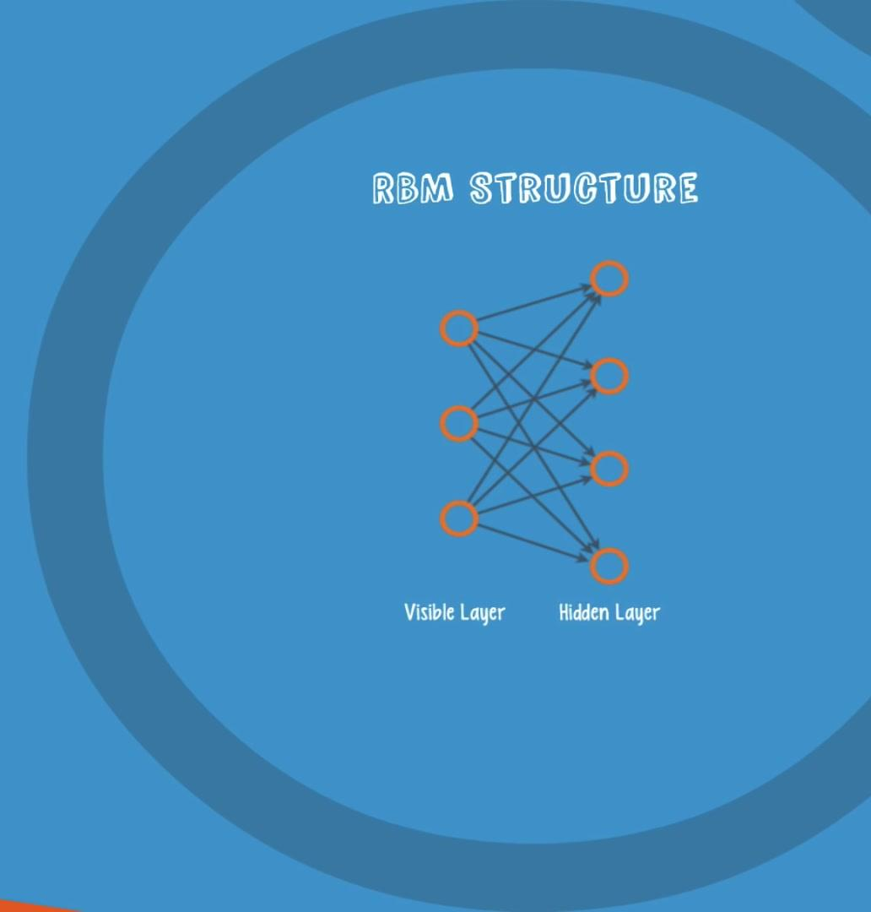
Restricted Boltzmann Machine
An RBM is a shallow, two-layer net; the first layer is known as the visible layer and the second is called the hidden layer.
Each node in the visible layer is connected to every node in the hidden layer

Slide 9
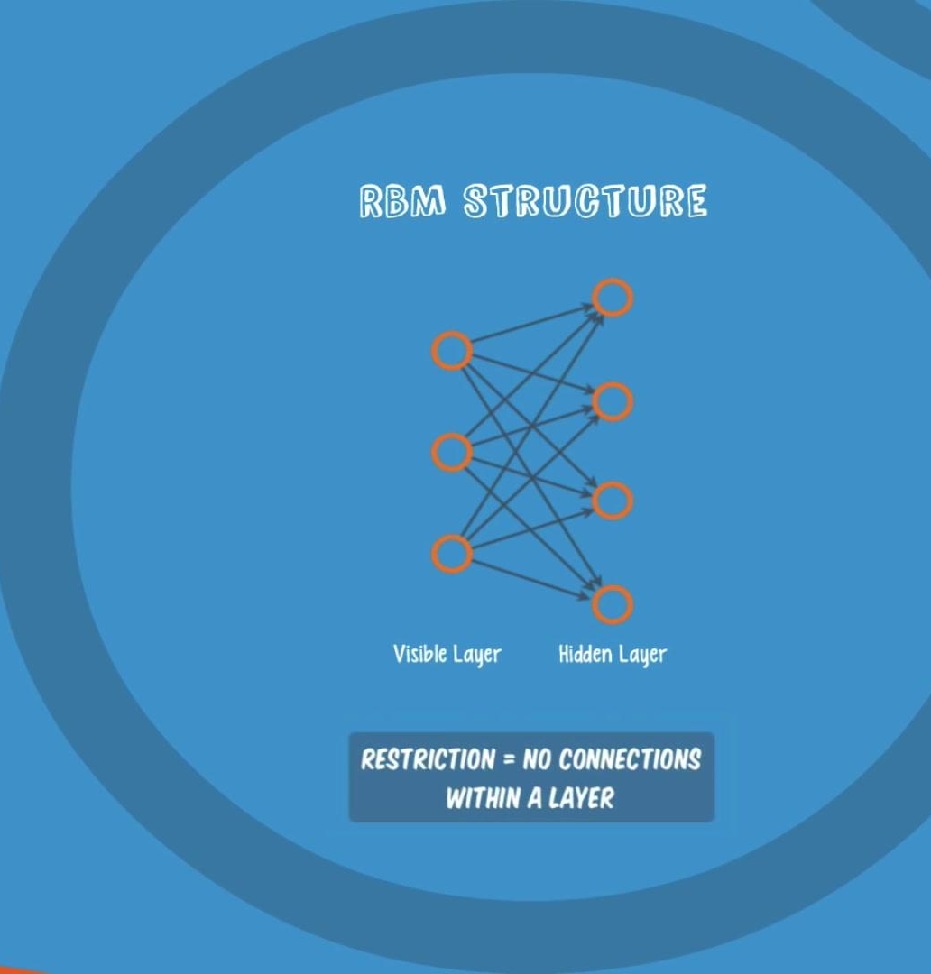
Restricted Boltzmann Machine
An RBM is considered “restricted” because no two nodes in the same layer share a connection.

Slide 10

An RBM is the mathematical equivalent of a two-way translator
In the forward pass, an RBM takes the inputs and translates them into a set of numbers that encode the inputs.
In the backward pass, it takes this set of numbers and translates them back to form re-constructed inputs. A well-trained net will be able to perform the backwards translation with a high degree of accuracy.
Notes:
In both steps, the weights and biases have a very important role. They allow the RBM to decipher the interrelationships among the input features, and they also help the RBM decide which input features are the most important when detecting patterns.

Slide 11
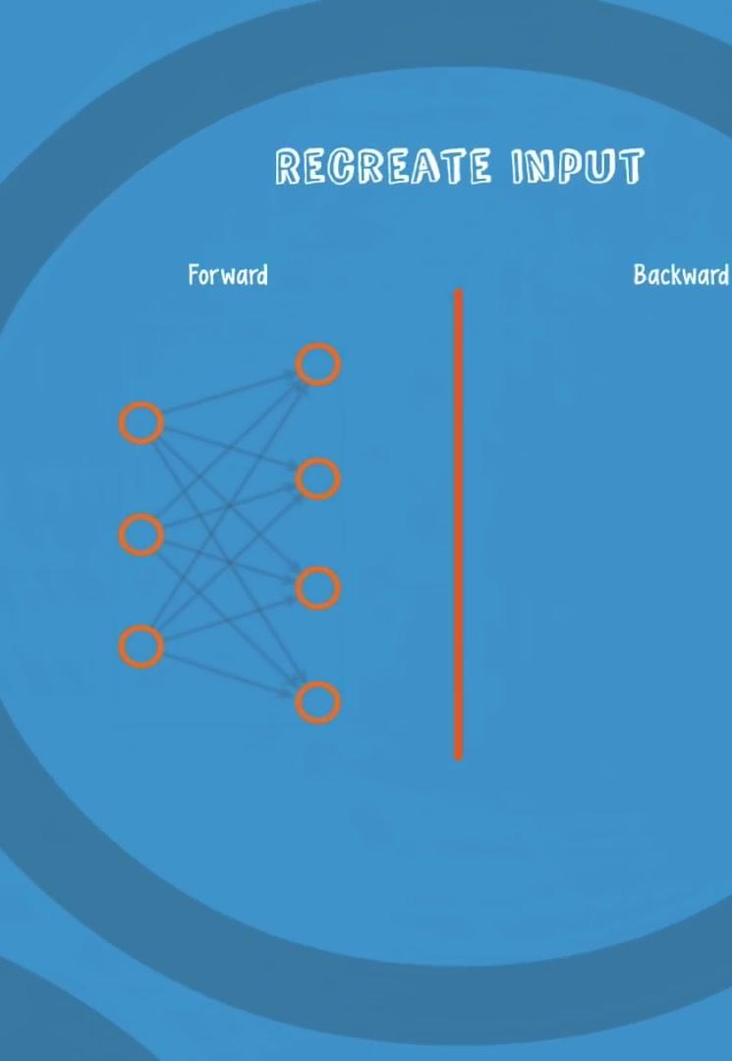
Through several forward and backward passes, an RBM is trained to reconstruct the input data.

Slide 12
Three steps are repeated over and over through the training process:
With a forward pass, every input is combined with an individual weight and one overall bias, and the result is passed to the hidden layer which may or may not activate. Here’s how it flows for the whole net.

Slide 13
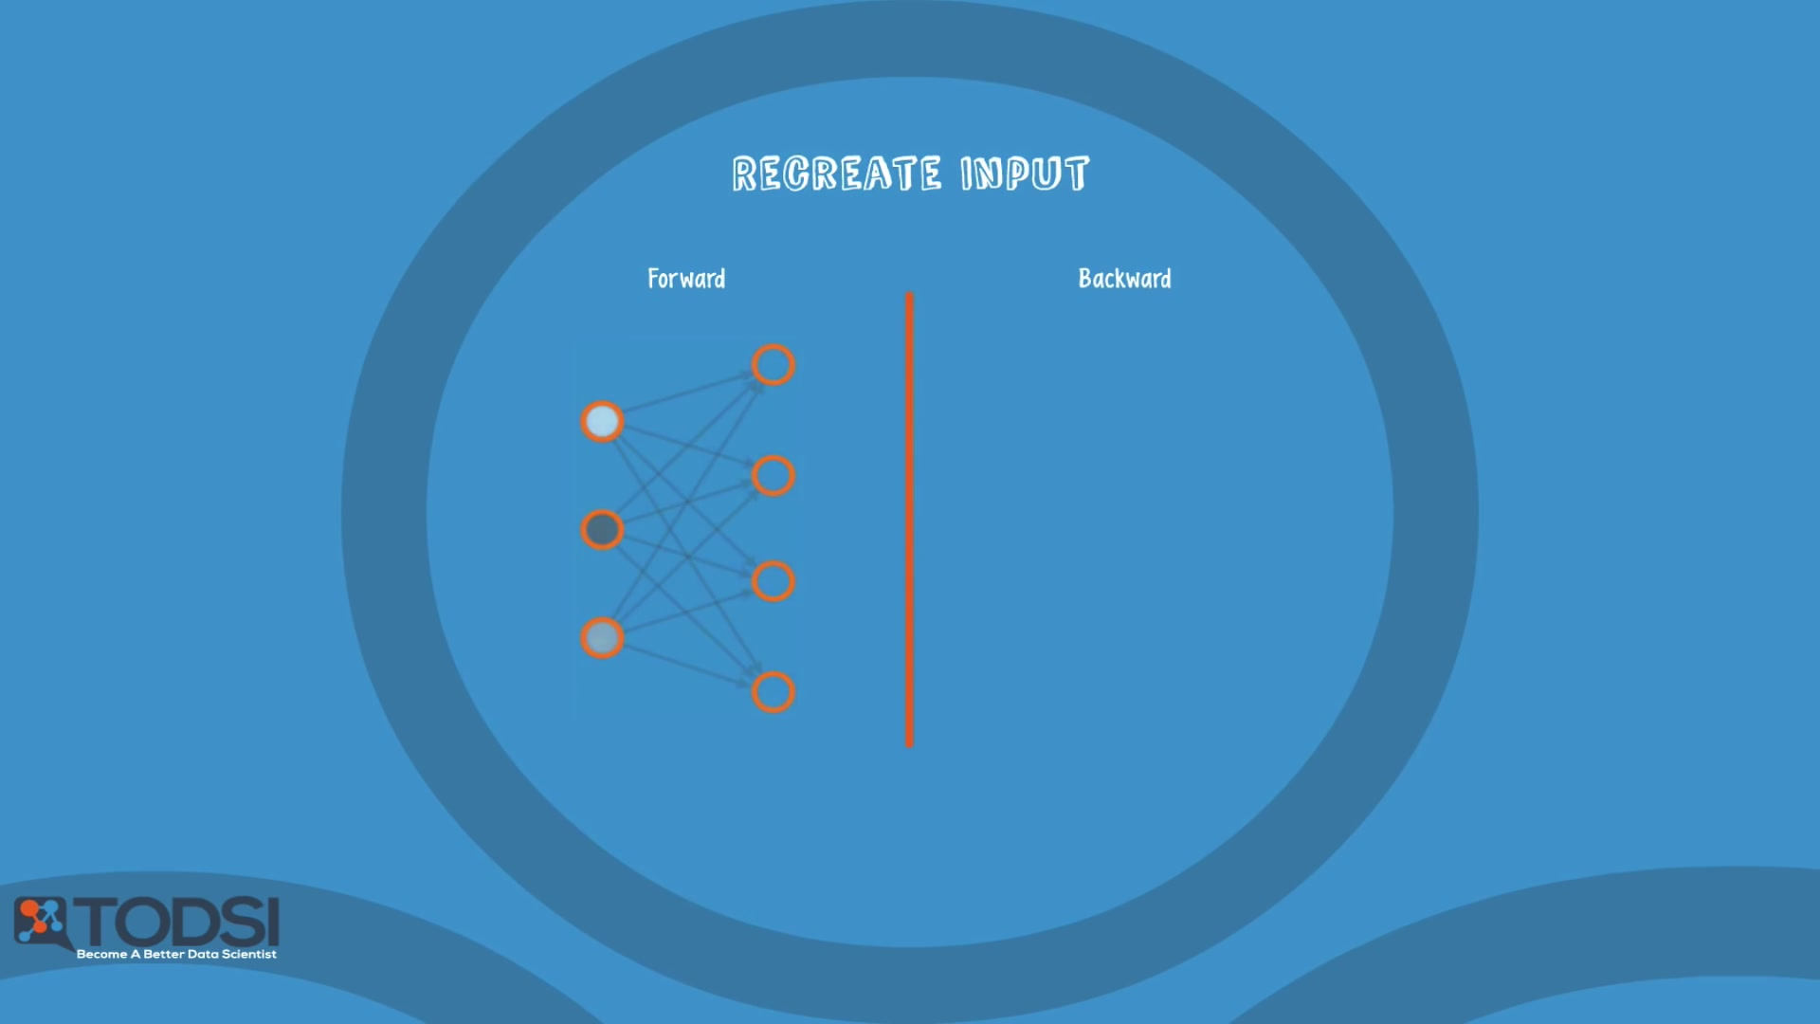
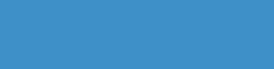
Restricted Boltzmann Machine

Slide 14
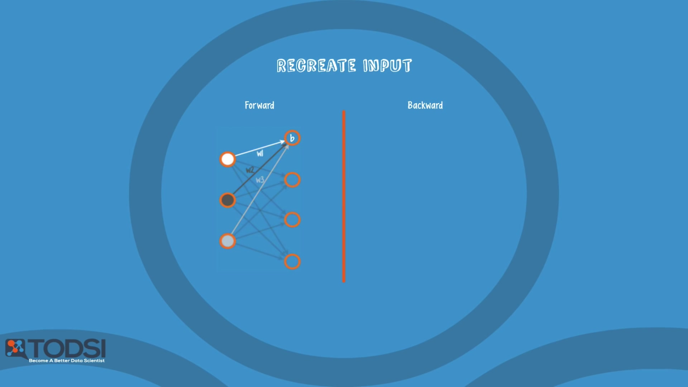
Restricted Boltzmann Machine

Slide 15
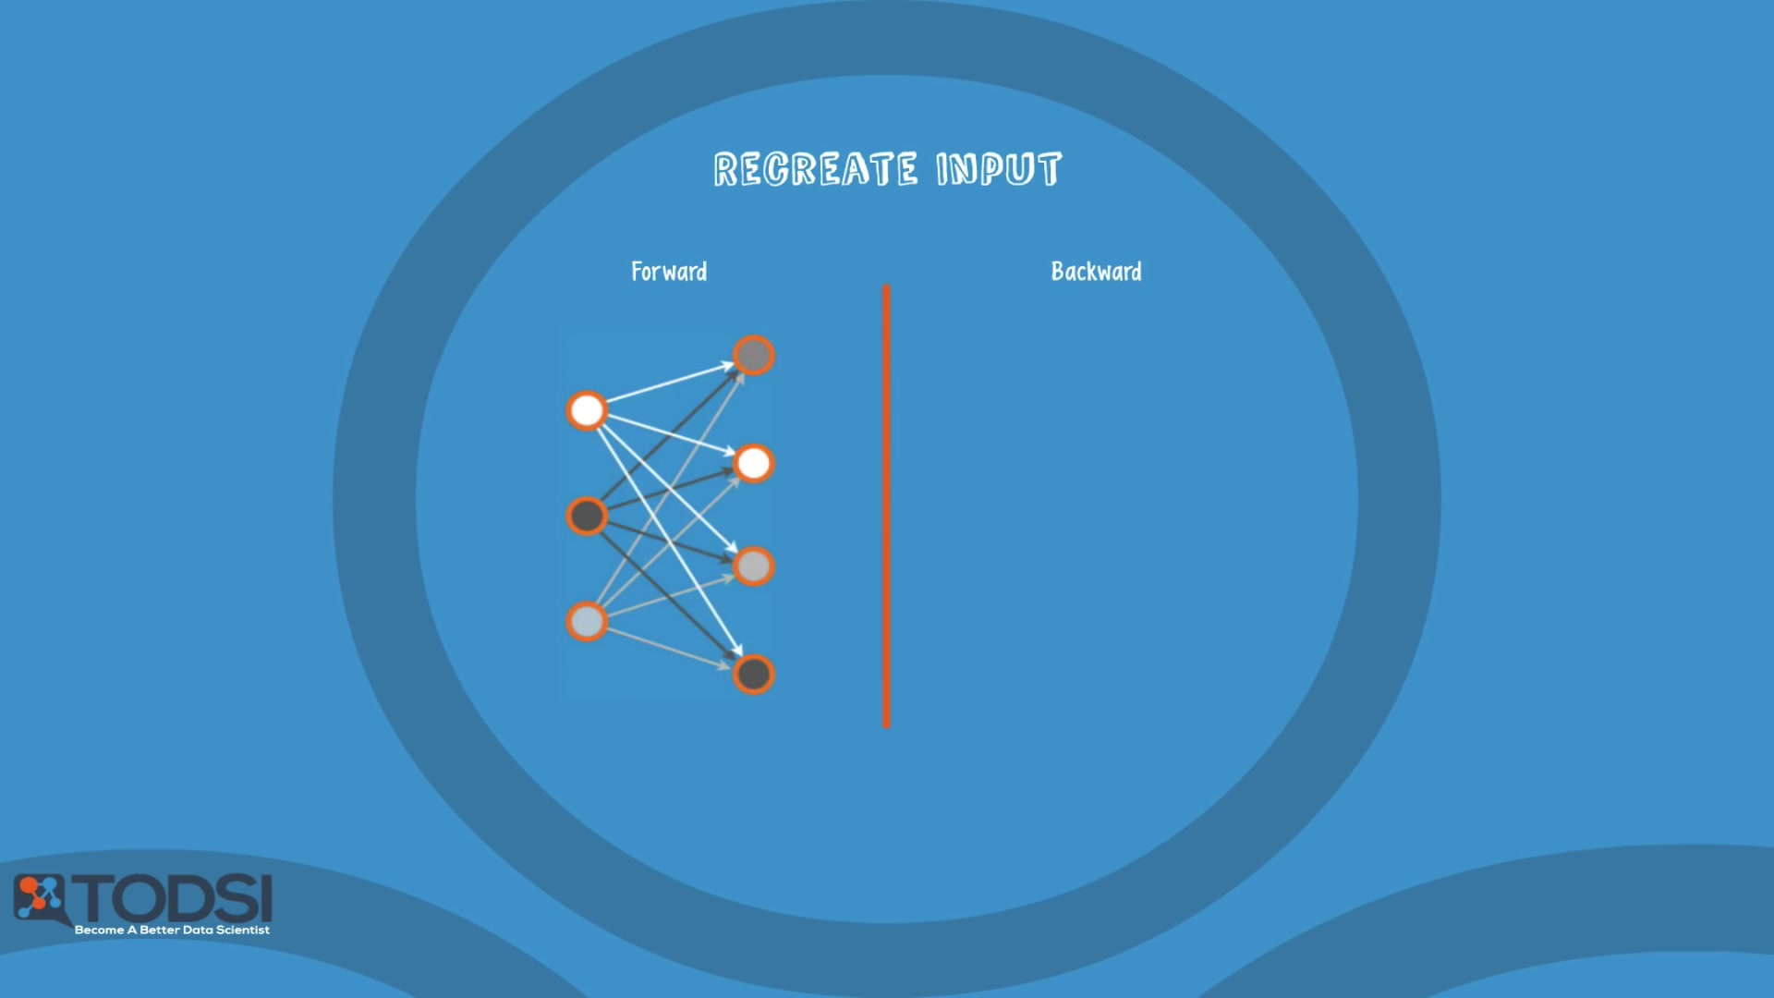
Restricted Boltzmann Machine

Slide 16
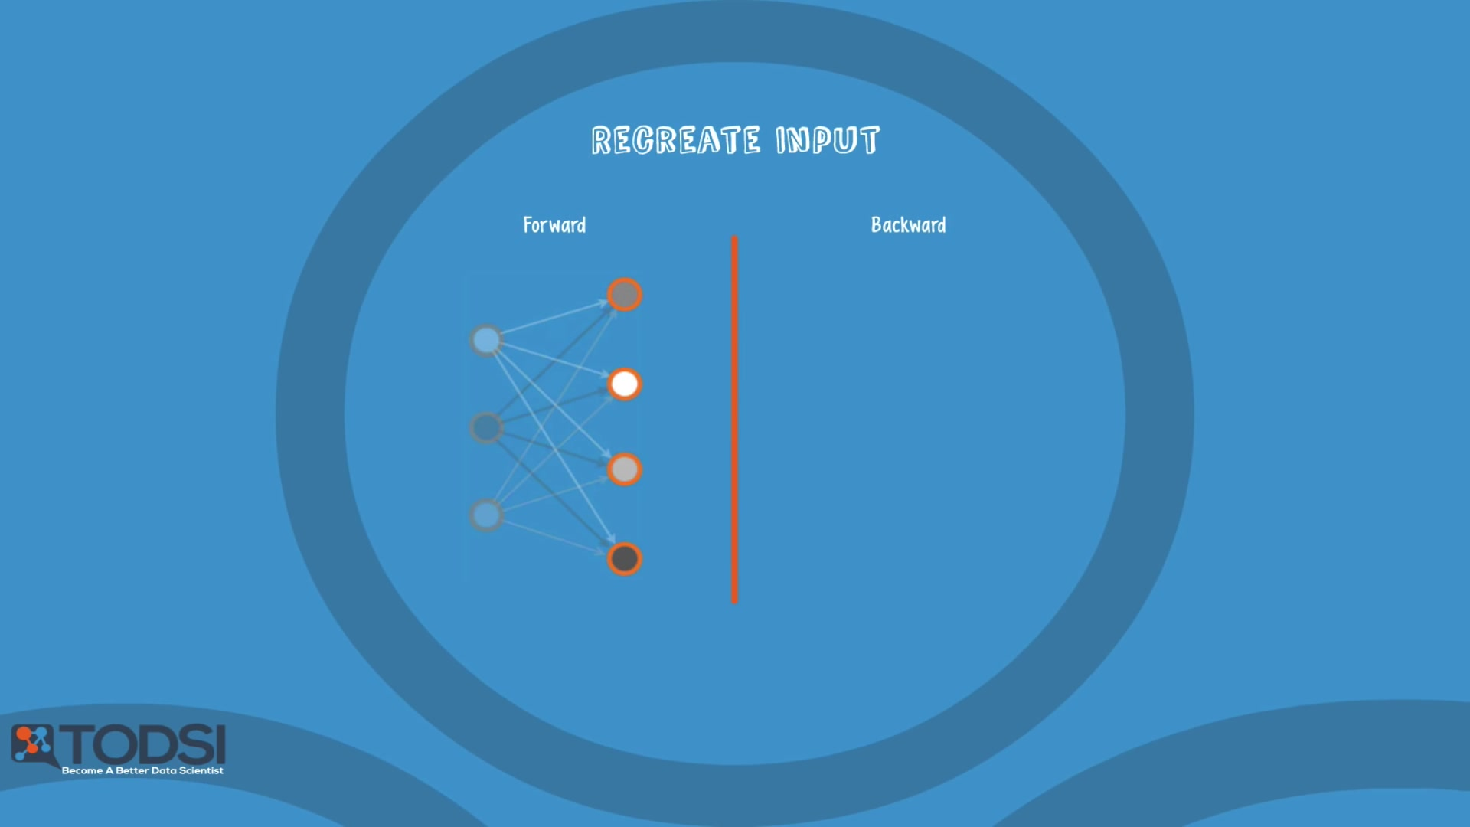
Restricted Boltzmann Machine

Slide 17

Restricted Boltzmann Machine

Slide 18
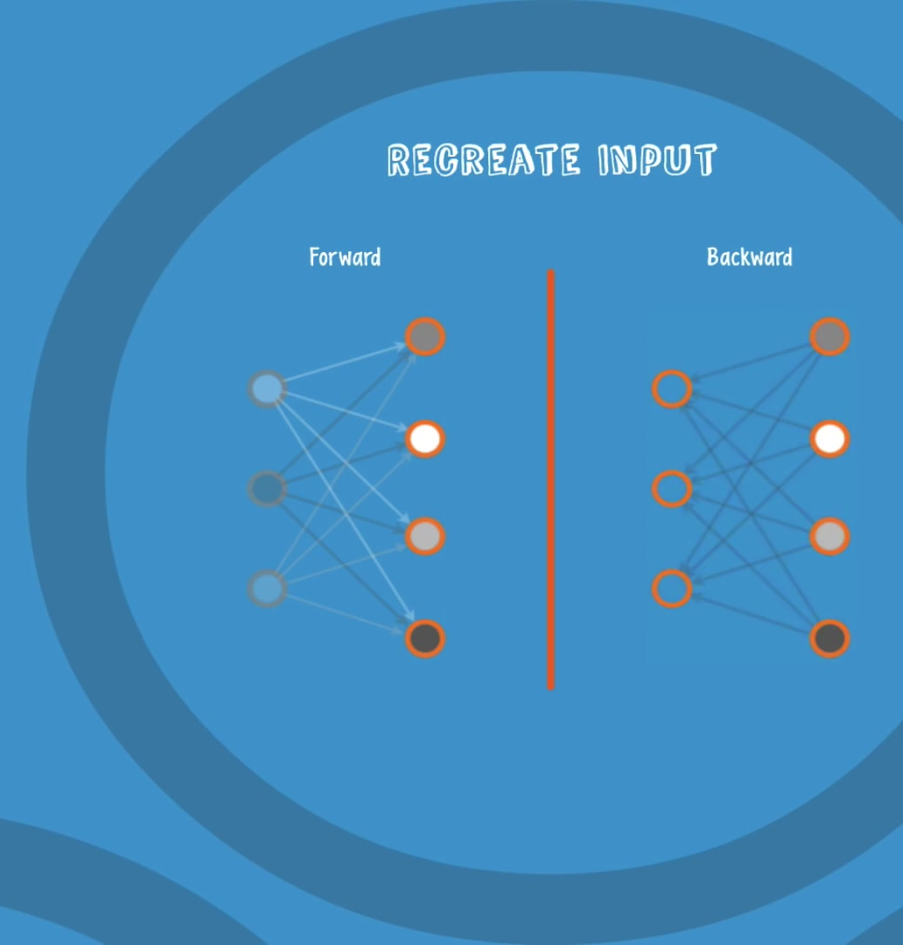
b.) Next, in a backward pass, each activation is combined with an individual weight and an overall bias, and the result is passed to the visible layer for reconstruction.
c) At the visible layer, the reconstruction is compared against the original input to determine the quality of the result.
Notes:
Here’s how it flows back.

Slide 19
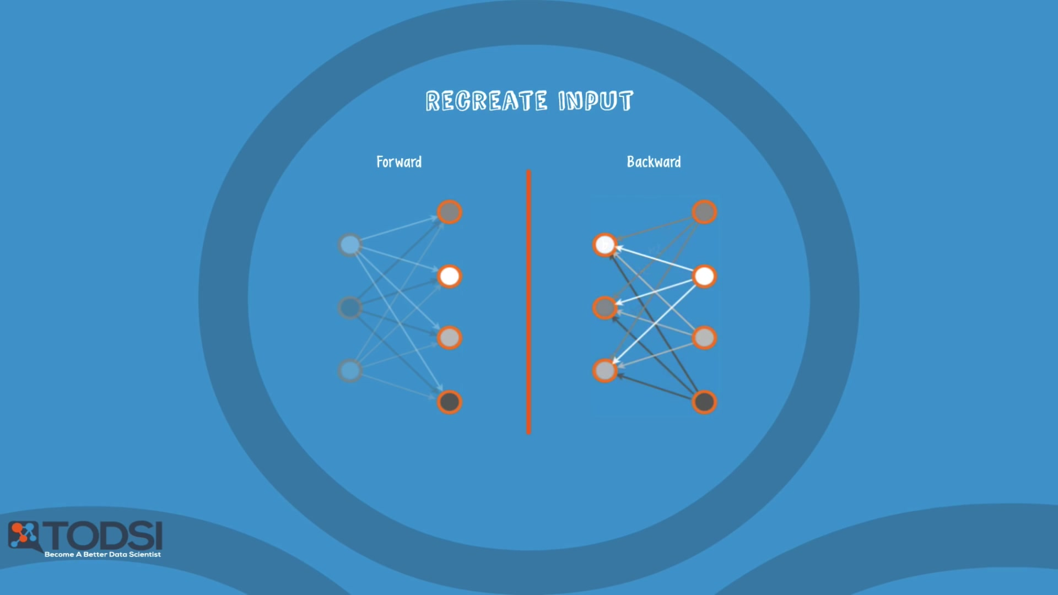
Restricted Boltzmann Machine

Slide 20
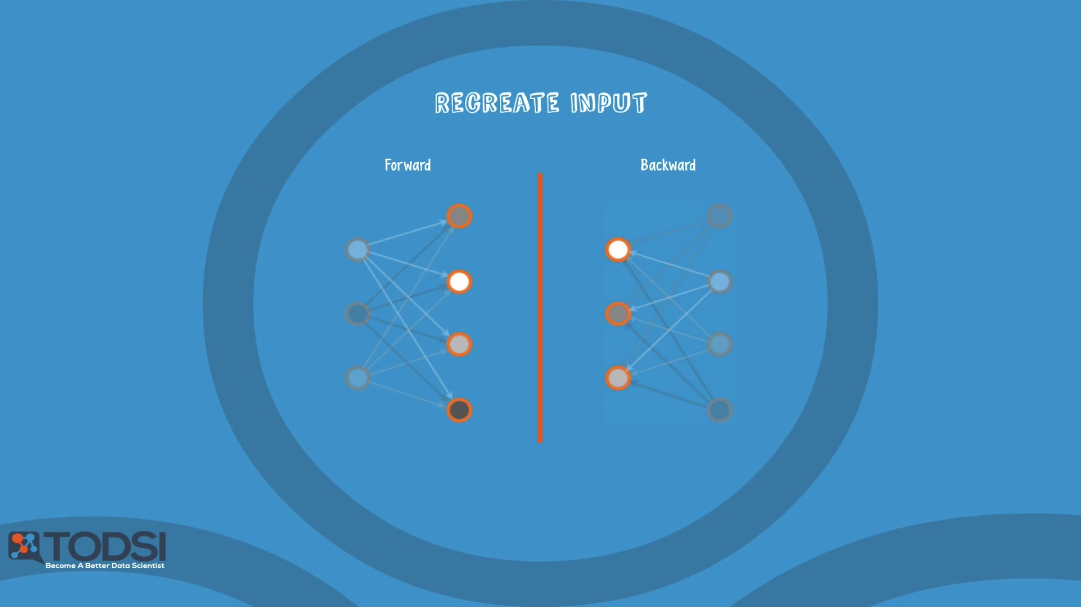
Restricted Boltzmann Machine

Slide 21
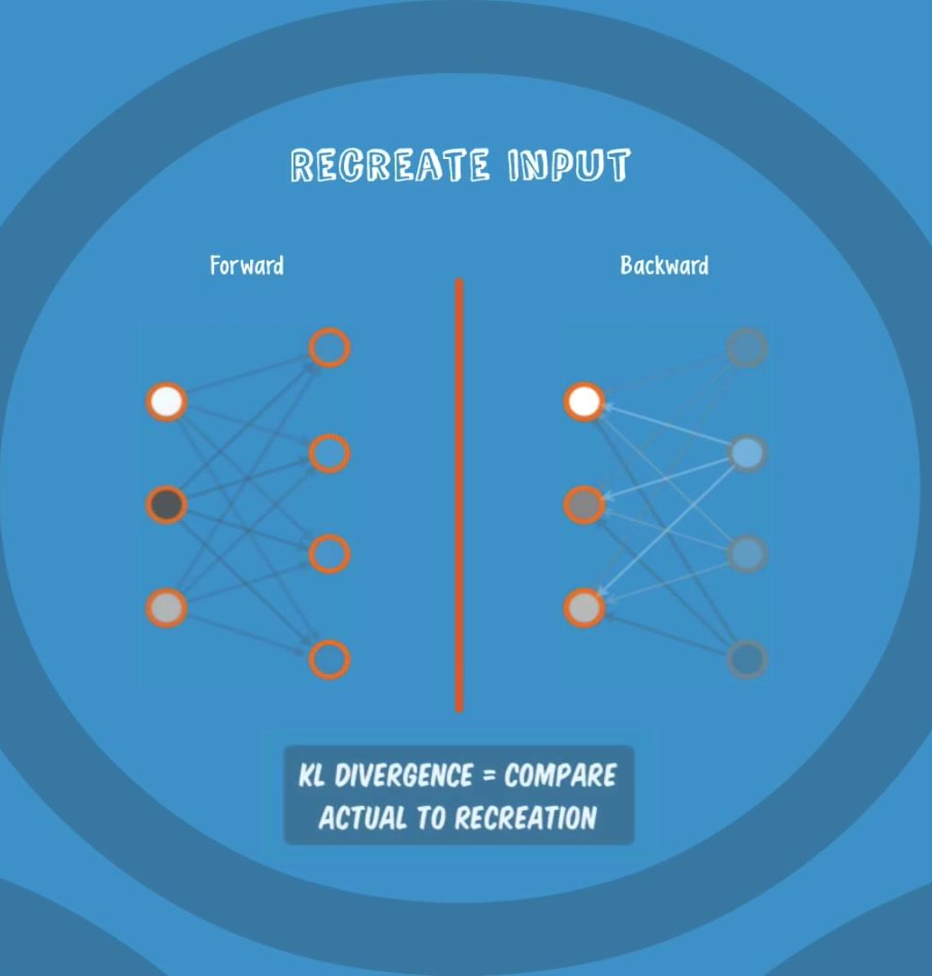
Restricted Boltzmann Machine
RBMs use a measure called KL Divergence for step c); steps a) thru c) are repeated with
varying weights and biases until the input and the re-construction are as close as possible.

Slide 22
An interesting aspect of an RBM is that the data does not need to be labelled. This turns out to be very important for real-world data sets like photos, videos, voices, and sensor data – all of which tend to be unlabelled.
an RBM automatically sorts through the data, and by properly adjusting the weights and biases, an RBM is able to extract the important features and reconstruct the input.

Slide 23
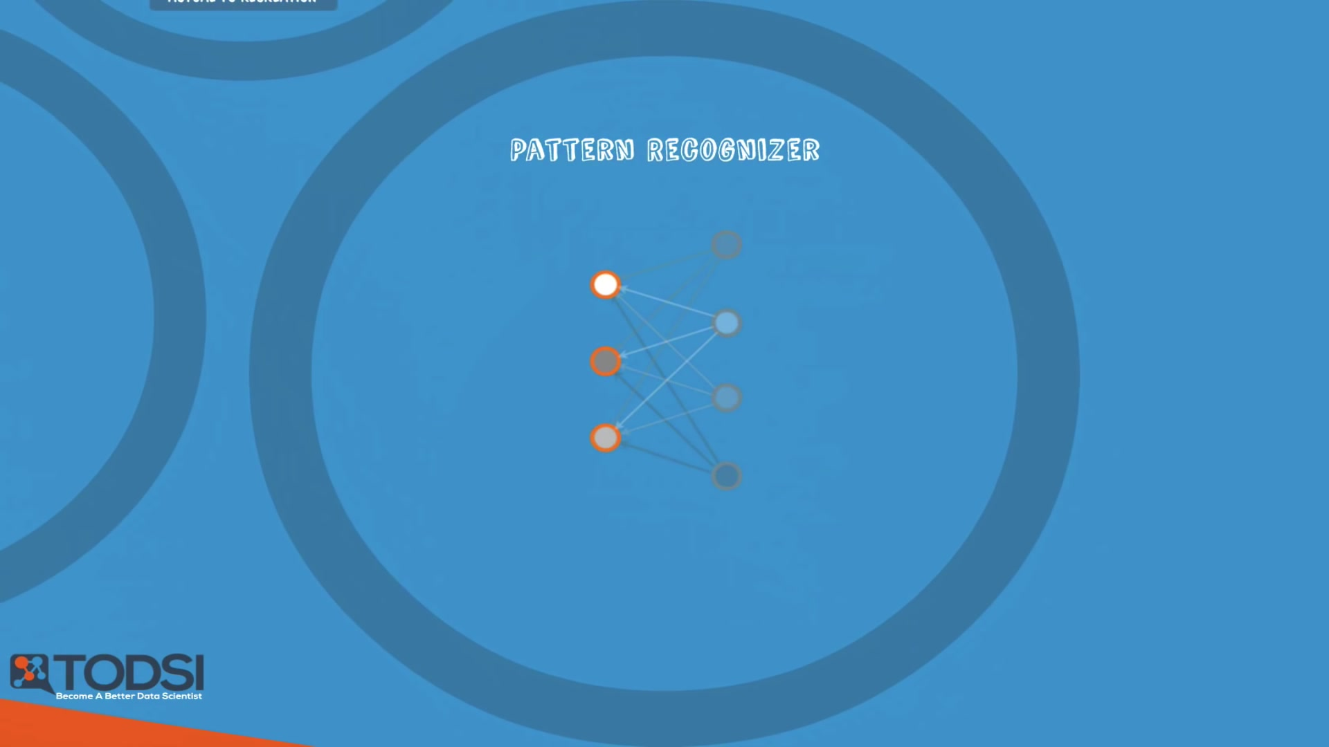
Restricted Boltzmann Machine

Slide 24
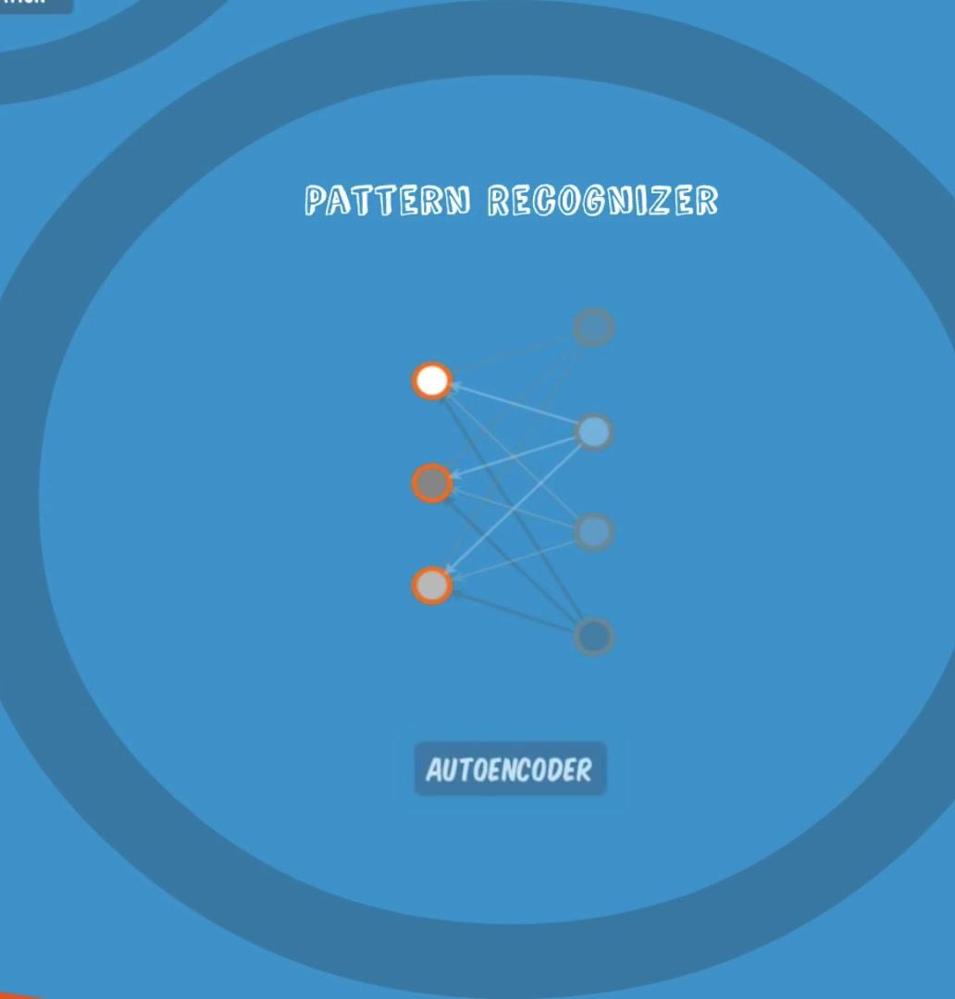
an RBM is part of a family of feature extractor neural nets, which are all designed to recognize inherent patterns in data. These nets are also called autoencoders.
Notes:
An important note is that an RBM is actually making decisions about which input features are important and how they should be combined to form patterns

Slide 25
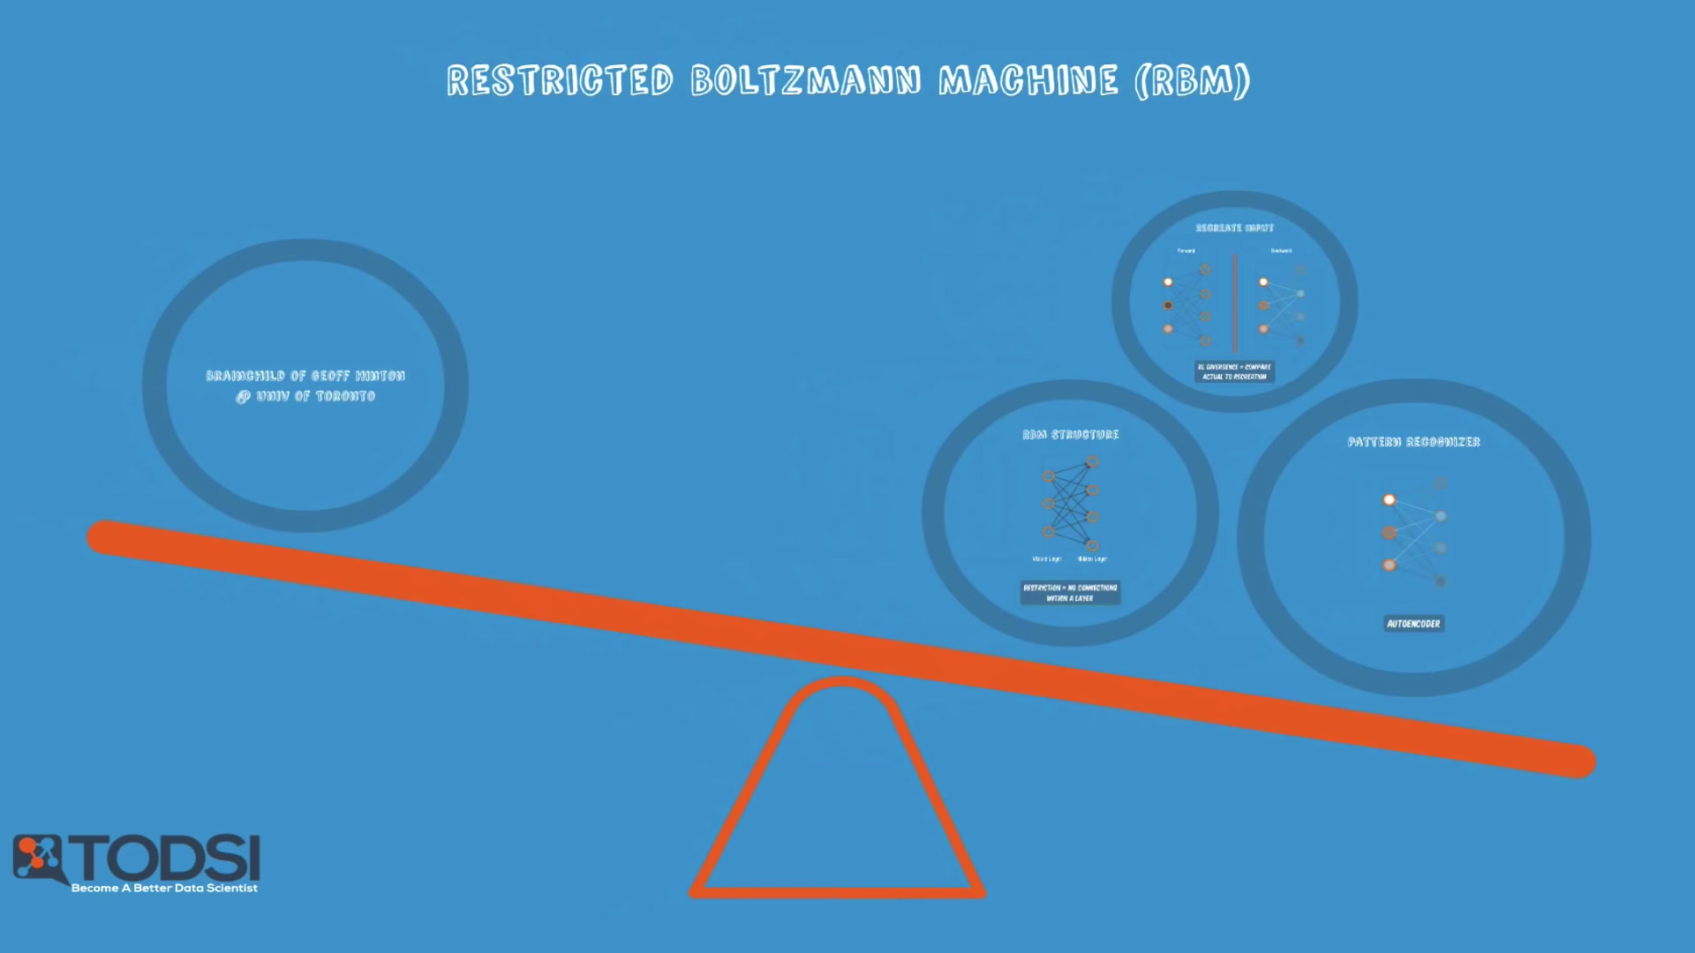
Restricted Boltzmann Machine

Slide 26





IKUTI KAMI
digitalent.kominfo
digitalent.kominfo
DTS_kominfo
Digital Talent Scholarship 2019
Pusat Pengembangan Profesi dan Sertifikasi
Badan Penelitian dan Pengembangan SDM
Kementerian Komunikasi dan Informatika
Jl. Medan Merdeka Barat No. 9
(Gd. Belakang Lt. 4 - 5)
Jakarta Pusat, 10110
digitalent.kominfo.go.id

